Slide 1
Drillthrough
Drillthrough

Slide 2
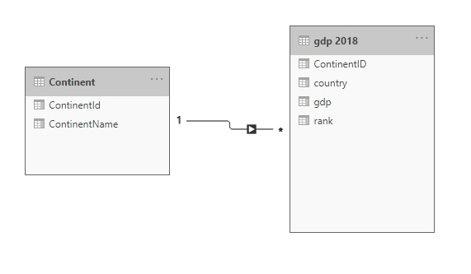
Drill through
Note: This Lab uses the gdp.xslx file located in the resources\Drillthrough and Filter folder
Navigate to the location of the gdp.xslx file and load both tables continent and gdp 2018 at the query editor level
Check that the relationship between contains and gdp 2018 is established

Slide 3
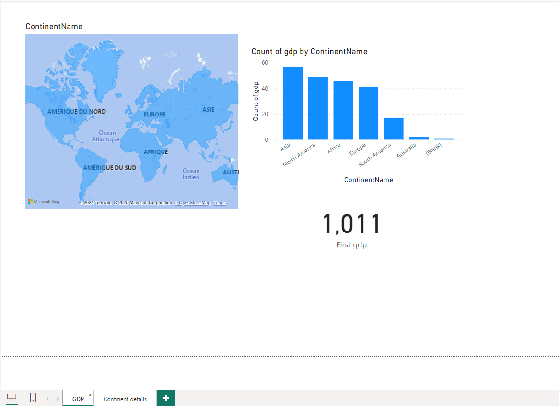
Drill through
Name the two pages of the report GDP and Continent details respectively.

Slide 4
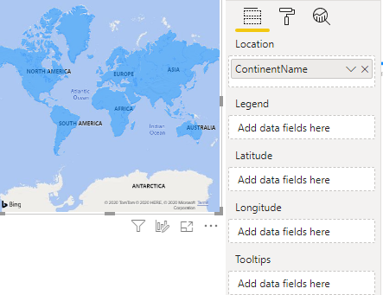
Drill through
Add three GDP page level visuals , a geographic map visual, a histogram visual and a label visual
ContinentName field to the Location property of the map

Slide 5
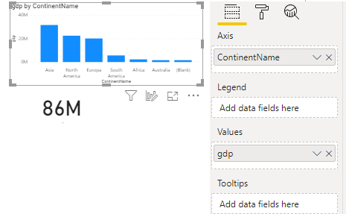
Drill through
ContinentName and gdp fields to the Axis and Values level respectively

Slide 6
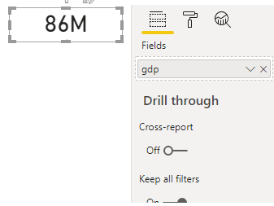
Drill through
Drag the gdp field to the Fields property

Slide 7
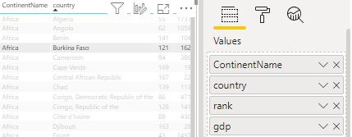
Drill through
Add a Table visual to the Details page level and drag the ContinentName , country , Rank and gdp fields to the Values property level

Slide 8
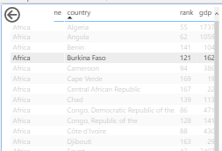
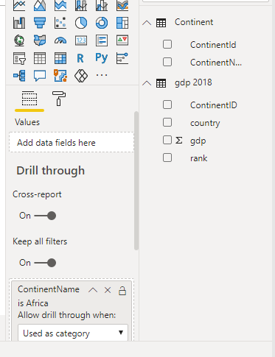
Drill through
Drag the ContainsName field to the Dill area through
Details page level

Slide 9
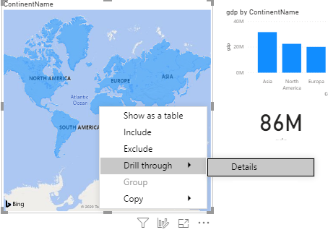
Drill through
Go back to the Gdp page and right click on Africa
Notice the presence of the Drillthrough menu

Slide 10
Drill through
Click the Details menu and observe what happens

Slide 11
Thank you
Thank you

